Slide 1
Virtual Memory

Slide 2
Why Virtual Memory?
Virtual Memory
  Not a physical device but an abstract concept.
  A technique that allows the execution of a process that may not be completely in memory.
Motivation:
  An entire program in execution may not all be needed at the same time.
    e.g. error handling routines, a large array, certain program features, etc

Slide 3
Advantage of Virtual Memory
Potential Benefits
  Programs can be much larger than the amount of physical memory. Users can concentrate on their problem programming.
  The level of multiprogramming increases because processes occupy less physical memory.

Slide 4
How of Virtual Memory
Implementation
  Demand Paging,
  Demand Segmentation

Slide 5
What is Virtual Memory?
Program:
  ....
  Mov AX, 0xA0F4
  ....
Mapping
Table
0xA0F4
Mapping
Unit
(MMU)
0xC0F4
Virtual
Address
“Piece“ of Virtual Memory
Physical Memory
“Piece” of Physical Memory
Physical
Address
Virtual Memory

Slide 6
Address Space and Memory Space
Virtual Address :
  Address generated by a programmer. Set of all such address is address space.
Physical Address
  Address in main memory. Set of all such addresses is memory space.
Example :
  Auxiliary memory storage : 1024K (K=1024)
  Main memory storage : 32K
  Address Space = 1024K
  Memory Space = 32K

Slide 7
Virtual Address to Physical Address Mapping
Convert 20-bit virtual address to 15-bit memory address.
Special hardware unit Memory Management Unit (MMU) performs translation.
check using mapping table
piece
in physical
memory?
OS brings
`piece` in
from HDD
virtual
address
memory
access fault
yes
OS adjusts
mapping
table
physical
address
translate
address
MMU

Slide 8
Memory Mapping Table
Virtual Address
Memory Mapping Table
Main Memory
Virtual Address Register
(20 bits)
Main memory Address Register
(15 bits)
Memory table buffer register
Main Memory buffer register

Slide 9
Memory Mapping Table
Memory mapping table can be stored in
  a separate memory.
  main memory
    Two memory access required.
  Associative memory

Slide 10
Demand Paging (1/2)
0x00
Page 0
Page 0
Page 1
Page 1
0x00
Page 2
Page 2
Block 1
v
v
Block 0
Page 3
Page 3
Block 1
Page 4
Page 4
Block 0
v
v
Block 2
Page 5
Page 5
Block 3
Page 6
Page 6
Block 3
v
v
Page 7
Page 7
Virtual memory
(divided into equal
size pages)
Page Table
(one entry per page
maintained by OS)
Physical memory
(divided into equal
size blocks/page frame)

Slide 11
Demand paging (2/2)
Virtual address represented by two numbers-
  Page no. and Line no.
  If 2^{P} words per page, p bits specify a line no. and remaining high order bits represent page no.
  Each page contains 1024 words i.e 2¹⁰
  High order 3 bits of virtual address gives page no. and lower order 10 bits line no.
Page 0
Page 1
Block 0
Page 2
Block 1
Page 3
Block 2
Page 4
Block 3
Page 5
Memory space M=4K = 2¹²
Page 6
Page 7
Address space N=8K = 2¹³

Slide 12
Page Table
Page table contains one entry for each page.
The address in the page table is the page no. and the contents of the word gives the block no. where that page is stored in main memory.
A valid bit in each entry of the page table indicates whether or not that page is in main memory. A 0 means page not in main memory.

Slide 13
Page no.
Line no.
101
0101010011
Virtual Address
Valid Bit
Table Address
000
0
001
Block 0
11
1
010
01
0101010011
Block 1
00
1
Block 2
011
0
Main Memory address register
Block 3
100
0
101
01
1
110
10
1
MBR
111
0
Page Table
01
1

Slide 14
Disadvantage
If main memory can store n blocks and there are m (m > n) entries in the page table, then m-n entries in the page table will always be empty.

Slide 15
Associative Memory Page Table
Virtual Address
101
Line Number
Argument Register
Page No
111 00
Key Register
001
11
010
00
Associative Memory
101
01
110
10
Page No
Block No

Slide 16
Associative Memory Page Table
Page table contains as many pages as number of blocks in main memory.
Each entry in page table contains page no. and block no.
Argument Register contains the virtual address.
Matching is done on the page no.
If match, word is read and its block no. is extracted.

Slide 17
Page Replacement
A program tries to access a page which is still in auxiliary memory. This is a page fault.
In case of page fault, the OS assigns the task of bringing the page from auxiliary memory.
If memory is full then some replacement policies are to be followed.
  FIFO
  LRU

Slide 18
Virtual Memory Architecture
VM is a combination of hardware and software.
Software handles
  Which page is to be replaced.
  When a new page is to be transferred to main memory.
  Where the page is to be placed in main memory.

Slide 19
Memory Management Hardware
Basic components of memory management unit
  Facility for dynamic storage relocation that maps logical memory references into physical memory addresses.
  Provision for sharing common programs stored in memory by different users.
  Protection of information against unauthorized access between users and preventing users from changing operating system functions.

Slide 20
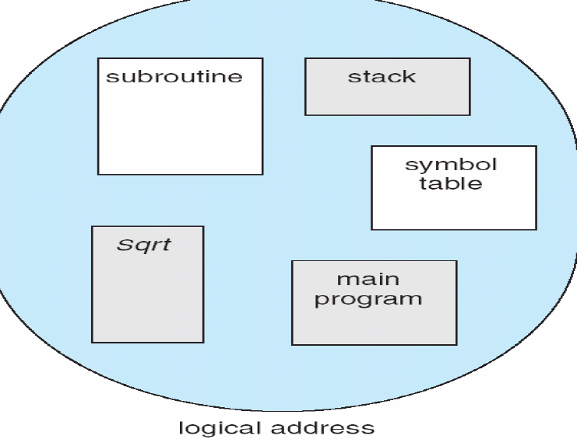
User View of a program

Slide 21
Segmentation (1/4)
In view of logical structure of programs, fixed sized pages are difficult to handle.
Program is divided into logically related but variable length segment, like, subprograms, arrays etc.
A process may execute while its current instructions and referenced data are in segments in main memory
Virtual Address is (Segment no., Offset)
The segment number is used to index a segment table.

Slide 22
Segmentation (2/4)
A word in the segment table consists of
  a flag indicating whether the segment is present in main memory
  if it is, the address in main memory of the beginning of the segment
  the length of the segment.
It is checked whether the offset within the segment is less than the length of the segment and, if it isn't, an interrupt is generated.
If a segment is not present in main memory, hardware interrupt is raised to the operating system, which may try to read the segment into main memory.
The operating system might have to remove other segments from main memory in order to make room in main memory for the segment to be read in.

Slide 23
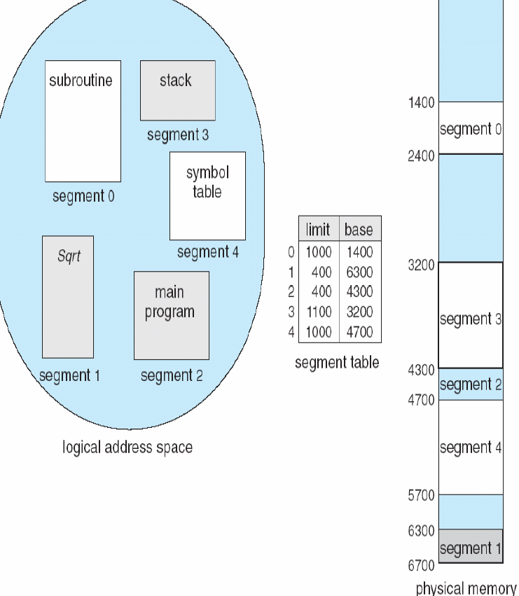
Segmentation (3/4)

Slide 24
Segmentation (4/4)
Hardware support
  - Multiple base/limit pairs, one per segment. (segment table)
  - Segments are named by segment #, used to index into table.
Segment Table
Main Memory
Limit
Base
Yes
Segment #
Offset
<?
+
Virtual address
No
Protection fault

Slide 25
Segmented Page Mapping
Combine segmentation and paging
  Use segments to manage logically related units.
    Code, data, heap, etc.
    Segments vary in size, but usually large (multiple pages)
Use pages to partition segments into fixed size chunks.
  Makes segments easier to manage with in physical memory
  Segments become “pageable” – rather than moving segments into and out of memory, just move page portions of segments
  Need to allocate page table entries only for those pieces of the segments that have themselves been allocated.
  No external fragmentation

Slide 26
Segmented Page mapping
Segment #
Page #
Offset
Virtual Address
Limit
Base
Block #
+
Segment table
Block#
Offset

Slide 27
Translation look-aside Buffer (TLB)
The segment table and page table may be stored in two different memories or in main memory.
To refer to a word in memory we needs 3 memory references.
To avoid this, a fast associative memory is used to hold most recently referenced table entries.
First time a block is referenced, its value and corresponding segment and page no is entered in TLB.
Mapping process first does associative search with given segment and page no.

Slide 28
Translation Look-aside Buffer
Segment #
Page #
Offset
1101
10010011
00101100
1111
11111111
00000000
1101
10010011
11001101
11001101
00101100
Segment #
Page #
Block #

Slide 29
Memory Protection
Physical Address
  assigning to each block of memory a number of protection bits that indicate the type of access allowed to that block.
  When block is moved, protection bits are updated.
Logical Address
  Protection bits in the segment table.
  Segment table entry (Base Address, Length, Protection)
  Length protects against access to memory not assigned to a process.
  Protection Information
    Full Read and Write
      Program executing its own instructions
    Read only
      Shared programs
    Execute only
      Protects programs from being copied
    System only
      Operating system programs

